Slide 1
Connect the Classroom
Webinar for Responsible Bodies and Schools
Autumn Term 2022
The session will begin at 2pm
This Photo by Unknown Author is licensed under CC BY-NC

Slide 2
Welcome & session objectives
Agenda
Housekeeping
Presenter Welcome/Context -15 mins
CTC Pilot (2021 – 2022)
School Feedback
CTC Phase 2 (2022 -2025)
Scope of Works - 15 mins
Standards
Eligibility
The Process 15 mins
Next Steps/Contacts/Questions -5 mins
Please mute your microphone and turn off your camera.
Please add questions to the chat window.
Please enter your preferred contact email address (1 per organisation as a minimum) in the chat window.
Slides will be e-mailed after the call

Slide 3
Pilot: What is Connect the Classroom?
In 2021-22 DfE
Worked with 1100 schools across England
Rural Gigabit Fibre programme schools
Schools in four Areas of Local Action
Grant funded upgrades to school networks that were based on condition/ need and compliant with DfE standards (the “ICT Output Specification”)
Worked closely with local partners such as responsible bodies to deliver the programme
Schools Engaged to date: 1500+
Funding Awarded to date: £32m
Installations in progress/completed: 970

Slide 4
School Feedback
“ I can now plan for a full lesson and don't loose at least 10 minutes delay in students logging on.”
“This has been a fantastic programme for our school. We had planned to upgrade our WiFi, but would not have had the same funding allowance to upgrade to the extent that we have, without this intervention”
“Great programme that has allowed us to really improve accessibility to technology more efficiently.”
“The process was easy to follow and the team at the DfE were excellent. Really responsive and ease of communication.”
“We would love to further upgrade our IT, but don't have the funds...hence, this scheme was a wonderful bonus for us.”

Slide 5
Phase 2 - 2022-25
£150m investment in school wireless networks over three years
Schools invited following on from the Rural Gigabit Broadband pilot programme and subsequently, schools meeting the eligibility criteria as mentioned in the introduction of the Education White Paper, March 2022
https://www.gov.uk/government/publications/opportunity-for-all-strong-schools-with-great-teachers-for-your-child
Condition based
Grant funded
School is the customer for procurement
System must comply with DfE technical standard for works to be approved
Repayment against invoices via the responsible body

Slide 6
Scope of Works
Where a replacement or addition is required, the programme will fund:
Wireless access points
Edge switches to service those access points
Core switches if required
Licensing to cover revenue costs for those products for the first 5 years as a minimum
Installation, configuration and handover to local team
If you have any school specific enquiries, please get in touch with one of our ICT Advisors who will be able to discuss further.

Slide 7
Digital & Technology Standards
Where we fund directly (eg Connect the Classroom), the GenericDesignBrief- Output Specification should be referred to.
Derogation allows for variation from this on a school-by-school basis and by exception only.
For schools carrying out their own procurement, we recommend that you refer to Meeting digital and technology standards in schools and colleges - Guidance - GOV.UK (www.gov.uk).

Slide 8
Eligibility
Three-year programme
Schools in a Priority Education Investment Area
Schools in Education Investment Areas rated as Requires Improvement or Inadequate at their last inspection
Year 1 (ending Mar 31st 2023) covers:
All eligible schools in the responsible bodies that were part-completed in the pilot
All remaining eligible schools in the SW region
Blackpool, Cambridgeshire, Doncaster, Hartlepool and East Sussex Education Investment Areas

Slide 9
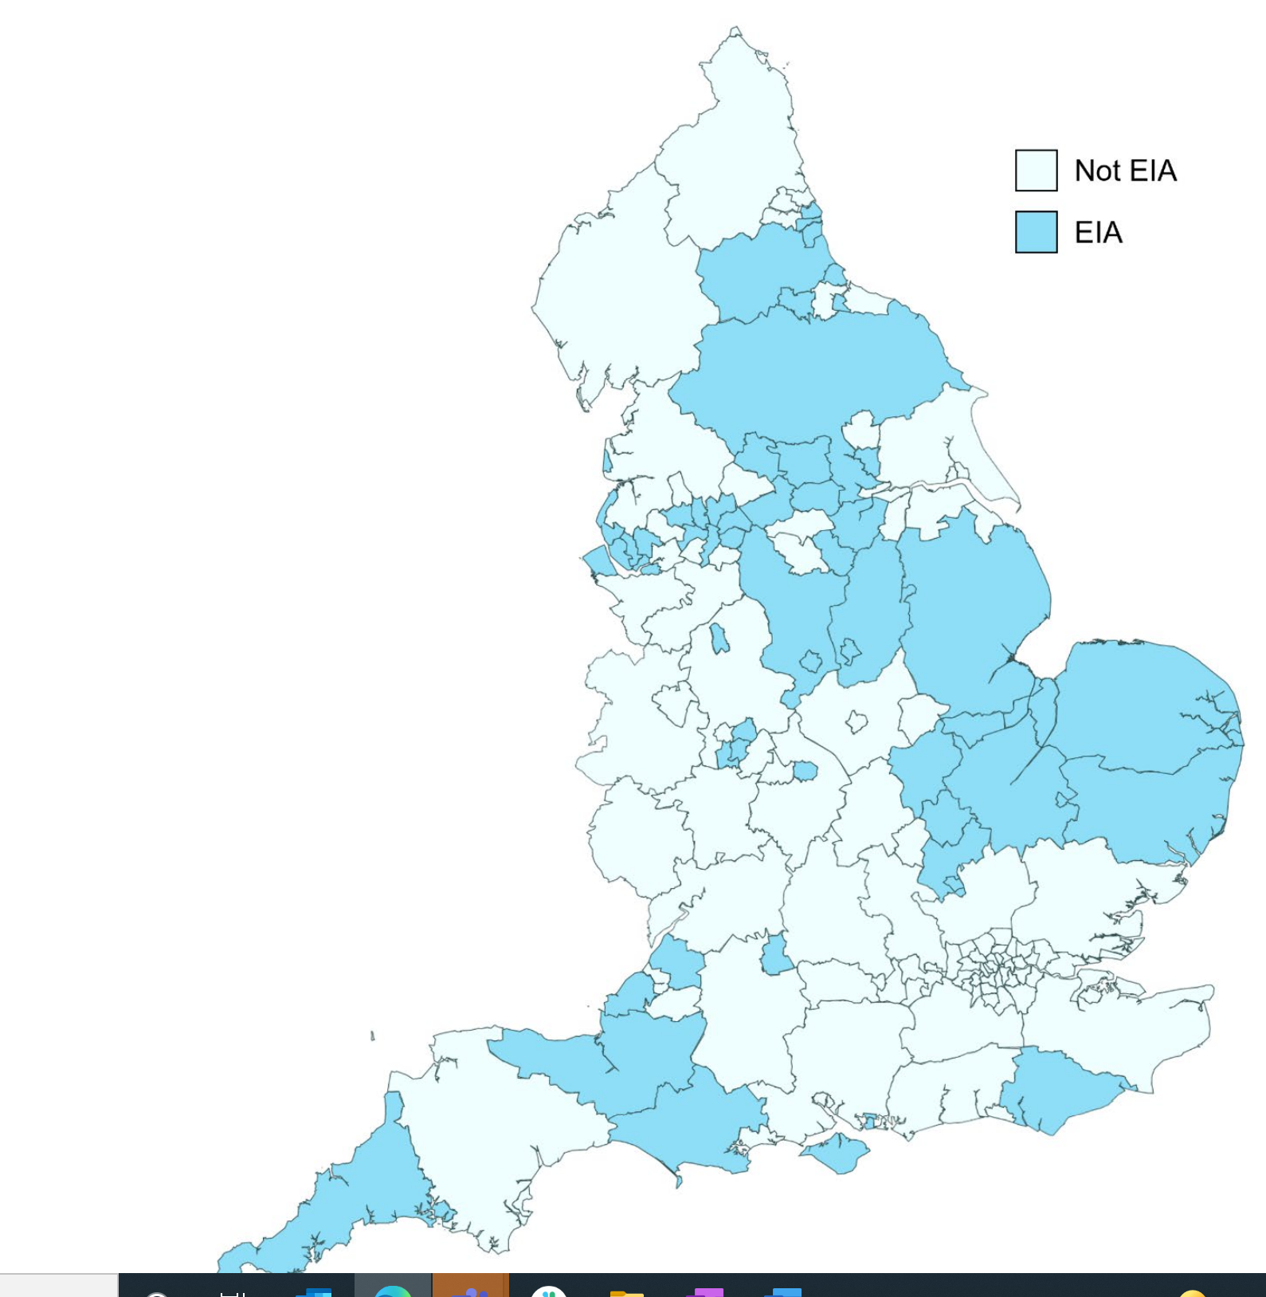
Education Investment Areas
Taken from Education Investment Areas Selection Methodology (publishing.service.gov.uk)
Bedford, Blackpool, Bolton, Bradford, Bury, Cambridgeshire, Central Bedfordshire, Cornwall, County Durham, Coventry, Darlington, Derby, Derbyshire, Doncaster, Dorset, Dudley, East Sussex, Halton, Hartlepool, Isle of Wight, Kirklees, Knowsley, Leeds, Lincolnshire, Liverpool, Luton, Manchester, Middlesbrough, Norfolk, North Northamptonshire, North Somerset, , North Yorkshire, Nottingham, Nottinghamshire, Oldham, Peterborough, Plymouth, Portsmouth, Rochdale, Rotherham, Salford, Sandwell, Sefton†, Somerset, South Gloucestershire, South Tyneside, St. Helens, Stoke-on-Trent, Suffolk, Sunderland, Swindon, Tameside, Wakefield, Walsall, Wirral

Slide 10
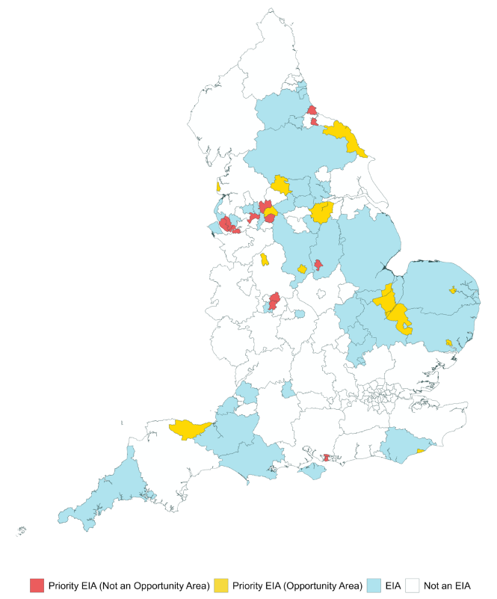
Priority Education Investment Areas
Taken from Priority Education Investment Areas Selection Methodology (publishing.service.gov.uk)
Blackpool, Bradford, Derby, Doncaster, Fenlands and East Cambridgeshire, Halton, Hartlepool, Hastings, Ipswich, Knowsley, Liverpool, Middlesbrough, North Yorkshire Coast, Norwich, Nottingham, Oldham, Portsmouth, Rochdale, Salford, Sandwell, Stoke-on-Trent, Tameside, Walsall, West Somerset

Slide 11
The Process
1. Eligibility
3. Procurement
4. Grant Award
2. Onboarding
5. Completion

Slide 12
1. Eligibility
Priority Education Investment Areas and Education Investment Areas (RI\In only)
Contact from DfE
School/Responsible Body (RB) CtC Lead identified, contact details added to the Departments CRM
Online Survey sent and to be returned by School/RB
Network Asset Form sent and to be returned by School/RB
Network Asset Form reviewed by DfE
Eligibility confirmed

Slide 13
2. Onboarding
Eligibility confirmed and approval granted
Scope of works identified
DfE Procurement Pack sent

Slide 14
3. Procurement
School/RB manage their own procurement following their procurement processes/procedures
Share the DfE Procurement Pack with the ICT contractors you invite to bid for the work
Bidding contractors should complete the ICT Cost Matrix and present an ICT Solution Design
School/RB to send the ICT Cost Matrix and ICT Solution Design Document of the successful contractor to the DfE for approval
Schools/RBs struggling to identify suitable ICT contractors for tender could use a Crown Commercial Framework www.crowncommercial.gov.uk

Slide 15
4. Grant Award
Funding approval will be granted by the DfE for a compliant design/specification which represents value for money
Funding Pack issued to School/RB
School/RB to commission the work
Technical evaluation to be complete by the successful ICT contractor
Any cost changes must be submitted to the DfE by the School/RB to allow an updated funding agreement to be issued

Slide 16
5. Completion
Installation complete, supplier handover
Full claim made to DfE (split claims can also be made for part of the works, multiple payments are allowed)
DfE QA Site Visits
Please note for CtC Wave 4 schools a claim must have been received before 31st March 2023 to secure the grant funding. Failure to do this may result in the grant being rescinded by the DfE.

Slide 17
Next Steps: DfE
We hope to have the first schools enrolled within weeks and all schools by the end of the October half-term
We will share with you next week:
This slide deck
An end-to-end process guide, including FAQs
One of the team should have already made contact with you. If you require any further information and/or copies of the updated paperwork for procurement please do get in contact.
By email: connecttheclassroom.dfeict@education.gov.uk
Please ensure that you provide the nature of the enquiry - Name of the school and URN within the subject line when contacting the team
E.g. Subject: NAF - Name of School - URN XXXXXX

Slide 18
Next Steps: Responsible Body
Please let us know quickly
Would you prefer DfE to directly contact your schools to onboard them?
Would you prefer to lead the process on their behalf?
Please let us know via email or within the chat bar, and if needed we can set up a meeting.
Thank you
The CtC Team

